Slide 1
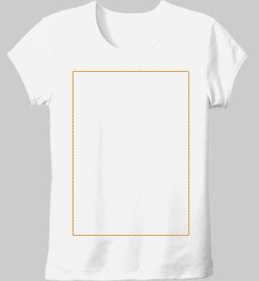
Tools and functions:
Pen tool
Color
Size
Save image
Change Background image
Canvas area for live drawing
Drawing map

